Slide 1

Financial News Sentiment Engine
Yike Meng
Qiancheng Ye
Joe Wang
Athena Huang
Yuting Du
Group #5
Date: 12/01/2025

Slide 2

Project Design
Build an integrated platform that captures and visualizes market sentiment derived from large volumes of financial news of the Magnificent 7 stocks.
Enable users to view daily sentiment, trends, and sector-level summaries through a front-end dashboard.
Data Sources: APIs provide raw news articles in JSON format.
ETL: Clean, parse, and standardize fields; compute sentiment scores.
Storage: Store raw data in MongoDB and export cleaned data to CSV/JSON files.
Analytics: Generate time-series metrics and visualizate sentiment trends
Scrapy Framework:Web scraping for financial news data collection when API sources insufficient.
VADER Sentiment Analyzer: Generate sentiment scores from article text.
MongoDB: Store raw JSON data and aggregated sentiment metrics.
Flask: powers REST APIs that deliver sentiment to the dashboard
1. Project Vision
2. Data Pipeline
3. Technologies

Slide 3
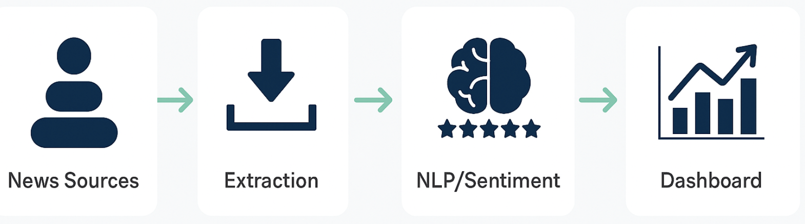
Motivation
–Why Build a Company News ETL Pipeline
1. News is a Primary Driver of Market Movements
Corporate news influences investor expectations, sentiment, and stock price volatility.
Earnings releases, product launches, regulatory events, and executive changes all originate from the news cycle.
Modern financial models increasingly incorporate real-time news streams as predictive signals.
2. News Data Exhibits Strong “Big Data” Characteristics
High volume: thousands of articles generated daily across companies and sectors.
High velocity: markets react within minutes of breaking news.
High variety: unstructured text, inconsistent formats, multilingual sources.
Requires scalable ETL pipelines to ingest, clean, and structure the data.
3. Clear Business Value for Analytics and Decision-Making
Market intelligence: track competitor and industry developments.
Sentiment monitoring: detect early signs of risk or opportunities.
Investment research: combine news sentiment with market data for richer insights.
Operational efficiency: automated retrieval avoids manual monitoring across dozens of sources.

Slide 4
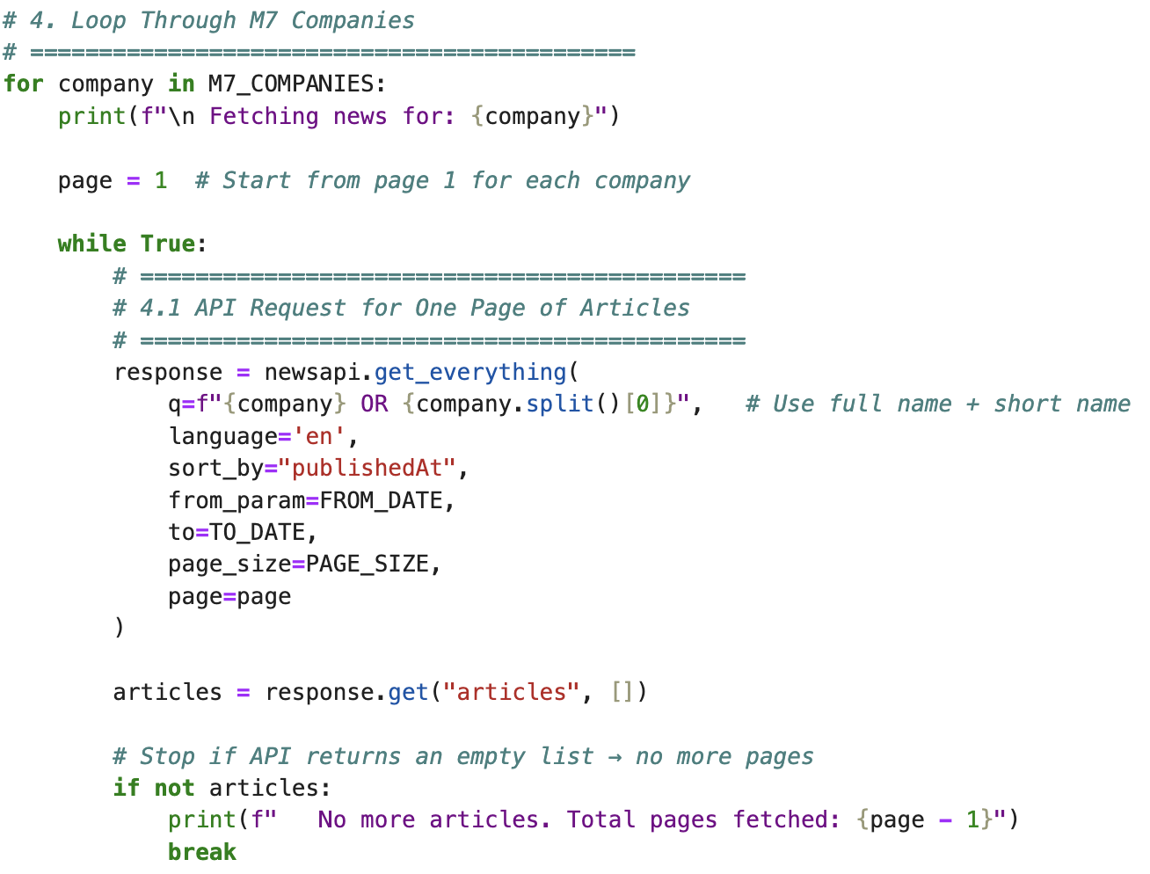

API-Based News Scraper
Data Source & Scope
Targeted M7 companies:
Apple, Microsoft, Amazon, Alphabet, Meta, Tesla, NVIDIA
Time range:
Jan 1, 2024 – Nov 24, 2025.
Language: English-only
Data Fields Extracted
Field | Description
title | News headline
description | Short summary
content | Main text snippet
published_at | Publication timestamp
source | Publisher
company | Magnificent 7

Slide 5
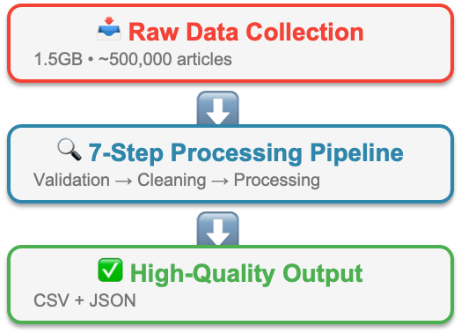
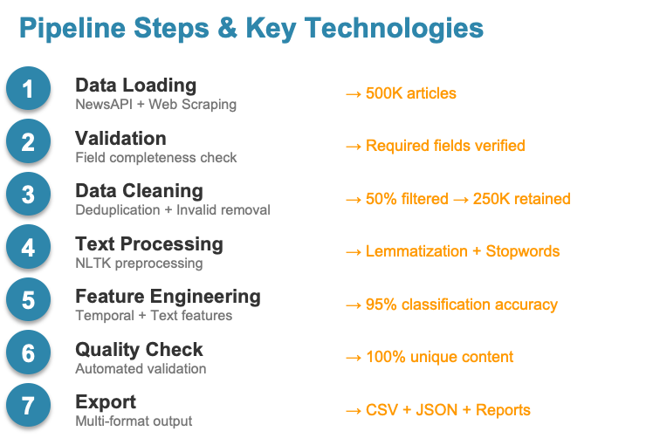
Data Processing Pipeline
From 1.5GB Raw Data to High-Quality Sentiment Analysis Dataset
improvement
Uniqueness
Accuracy
Articles
50%
100%
95%
250K
Filtered low quality data
No duplicates
Company matched
High quality dataset

Slide 6
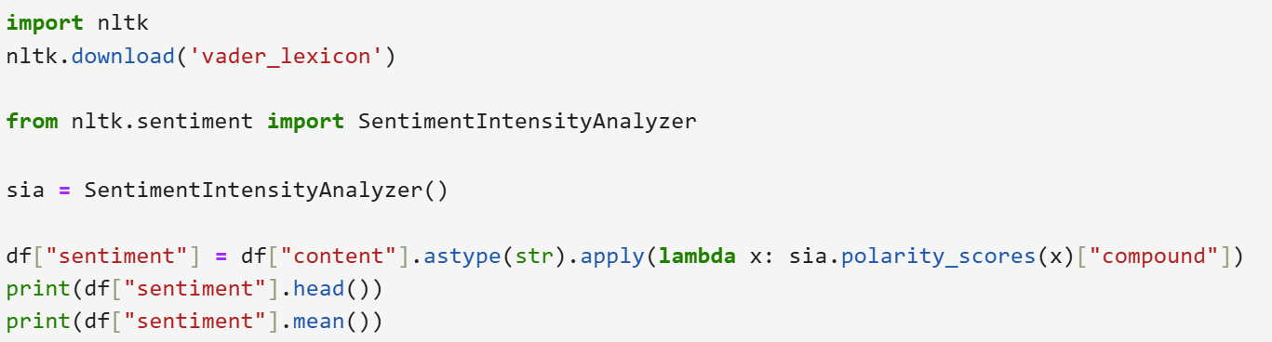
Why NLTK (VADER)?
Applied VADER sentiment analysis from NLTK
Generated compound sentiment scores (range: –1 to +1) for each article
Calculated overall mean sentiment to understand the dataset’s general emotional direction
How it works?
Sentiment Analysis Method
Easy to implement and requires no training.
VADER is perfect for short text (like news, posts, reviews).
Good for informal text like slangs or emojis.
Indicates a positive attitude towards Meta

Slide 7
How it works?
Sentiment Analysis Method
Indicates a positive attitude towards Meta

Slide 8
MongoDB - Data Storage & Aggregation
Goal
Workflow (Jupyter Notebook)
Output
Data Ingestion & Storage: Efficiently ingest large JSON datasets using MongoDB, which stores documents flexibly without requiring predefined schemas.
Cleaning & Transformation: Parse and standardize raw data, then compute aggregated sentiment metrics to enable reliable time-series analysis and visualization.
Load raw JSON data
Store flexibly in MongoDB
Parse and standardize key fields (e.g. dates and sentiment values)
Validate consistency against the raw dataset
Aggregate daily company-level sentiment metrics
Transition cleaned data into Spark for scalable processing
Clean dataset with normalized fields and sentiment.
Daily company sentiment summaries ready for visualization, and processing.
Date

Slide 9
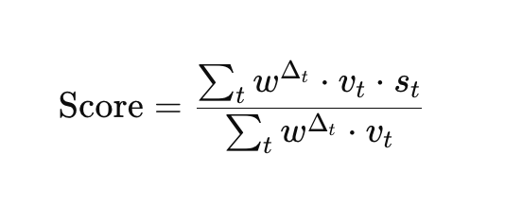
Flask
Key api Endpoints
Score formula
Backend
Connects to the dataset for the entire sentiment dashboard.
Retrieves raw news & sentiment records from MongoDB.
Cleans, aggregates, and transforms data into frontend-ready JSON.
Implements REST API endpoints used by charts and UI components.
Performs server-side computation to keep the frontend lightweight.
/api/company_summary — overall sentiment + date range
/api/company_stats — time-series sentiment + breakdown + counts
/api/articles — paginated news with score, label, and metadata

Slide 10
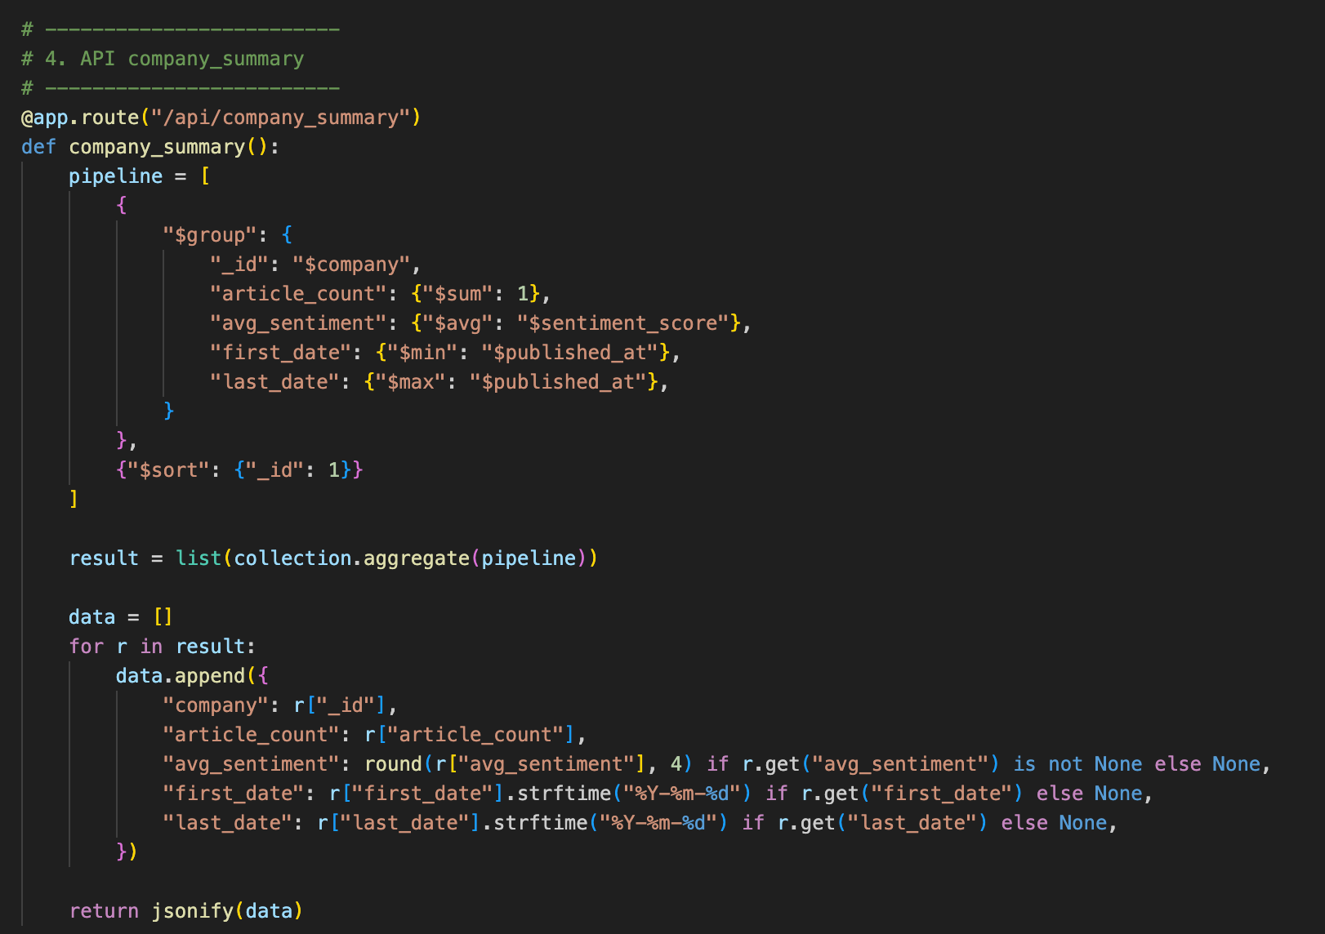
Building the key APIs
company_summary
Package / Tool | Role
Flask | Web framework creating /api/... endpoints；returns JSON using jsonify()
Flask-CORS | Allows JavaScript frontend to call Flask API
PyMongo | MongoDB driver for Python
Datetime / Math / Numpy | Used for time-decay weighting & EMA-like scoring
Custom Python Modules | Implement sentiment scoring logic
JSON (Flask jsonify) | REST response format
First, design RESTful route endpoints to query receive parameters from the front end (such as company name and date range).
Next, use PyMongo to execute efficient Aggregation Pipeline operations for filtering, grouping, and aggregating the data.
Finally, in the Python layer, apply a custom time-decay algorithm to weight the sentiment scores, serialise the cleaned data into JSON format, and return it to the front end to support dynamic chart rendering.

Slide 11
Frontend
Tool | Purpose
JavaScript ES6 | Core logic, fetch API, UI interaction
Chart.js | Visualizations: trend line + sentiment breakdown pie
Bootstrap 5.3 | Responsive UI & layout
Browser Fetch API | Calls Flask REST API endpoints
Regular Expressions (JS RegExp) | Clean article titles and descriptions

Slide 12
Business Use Case & Future Enhancements
Use Case 1 -
Investors & Analysts
Use Case 2 - Corporate Teams
Future Enhancement
Cost
Expand Stock Selection
Real-time Alerts: Notify users when sentiment drops sharply or article volume spikes.
Correlation Analysis: Examine relationships between sentiment trends and stock price movements.
Predictive Modeling: Use historical sentiment and price patterns to forecast future market behavior.
Compare sentiment across competitors
Monitor public perception over time
Assess how major announcements influence market sentiment
Track sentiment trends to inform buy/sell decisions
Monitor news impact on companies and sectors
Identify early signals of risk or opportunity
API Paid Account
Data Storage
Web Maintenance
We will use NEWSAPI Business plan for broder API search and download.
$449/per month
Started free, up until 512 MB storage, but cost incurs as data grows; additional cost is associated with cloud backups.
5GB Storage ~
$25/ per month
Cloud Hosting for Flask backend and Sentiment Dashboard.
$15/ per month

